Slide 1
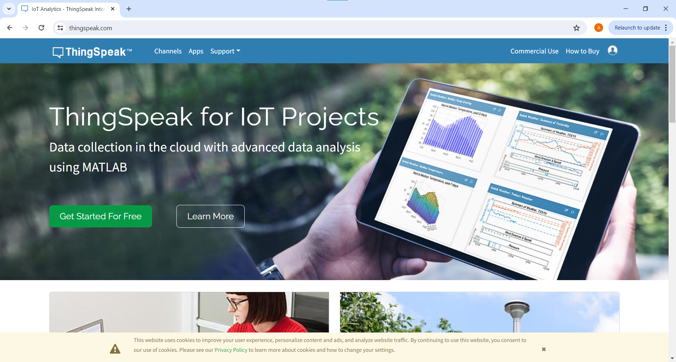
Mene osoitteeseen thingspeak.com ja klikkaa vihreästä napista

Slide 2
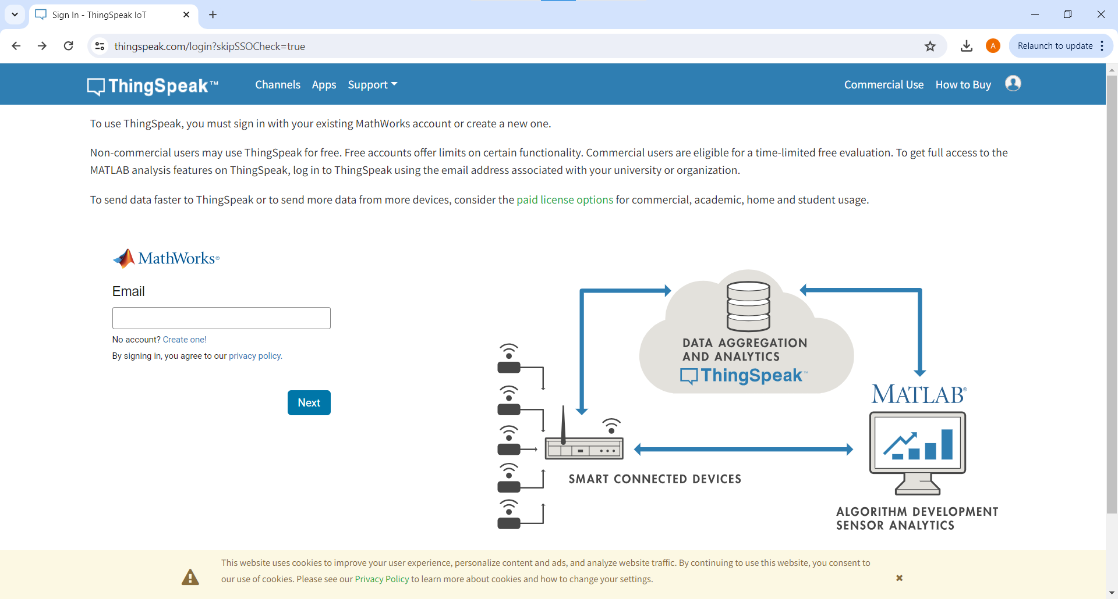
Luo tili

Slide 3
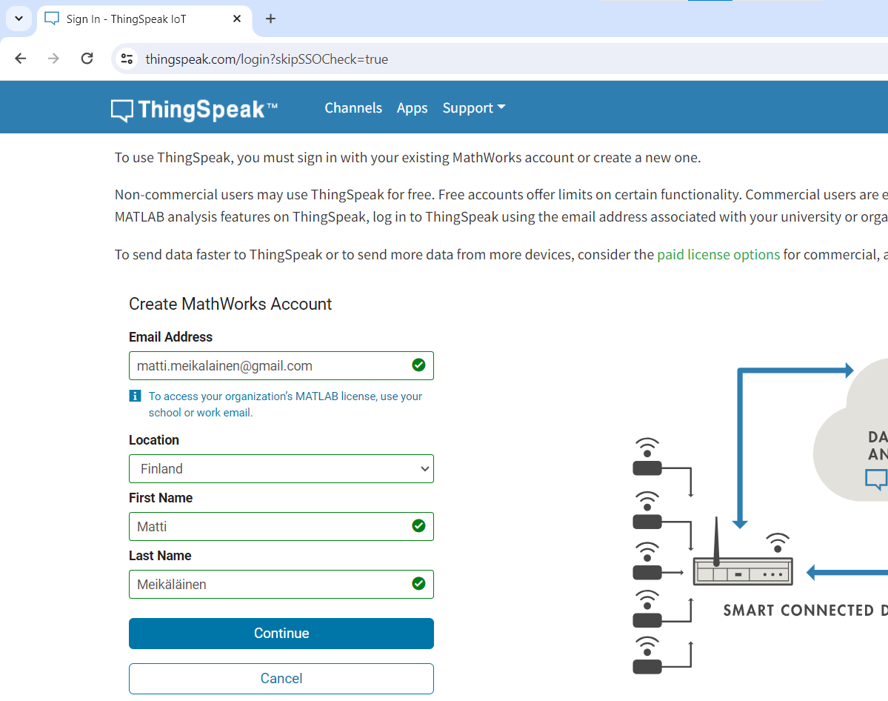
Täytä omat tiedot ja klikkaa Continue

Slide 4
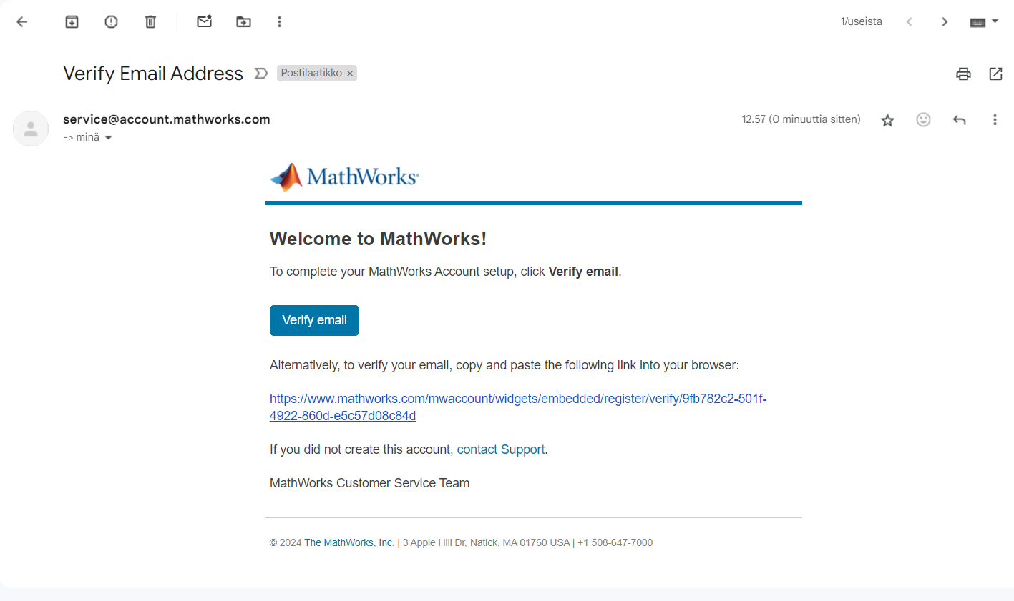
Mene sähköpostiin ja avaa viesti “Verify Email Address” ja klikkaa Verify Email

Slide 5
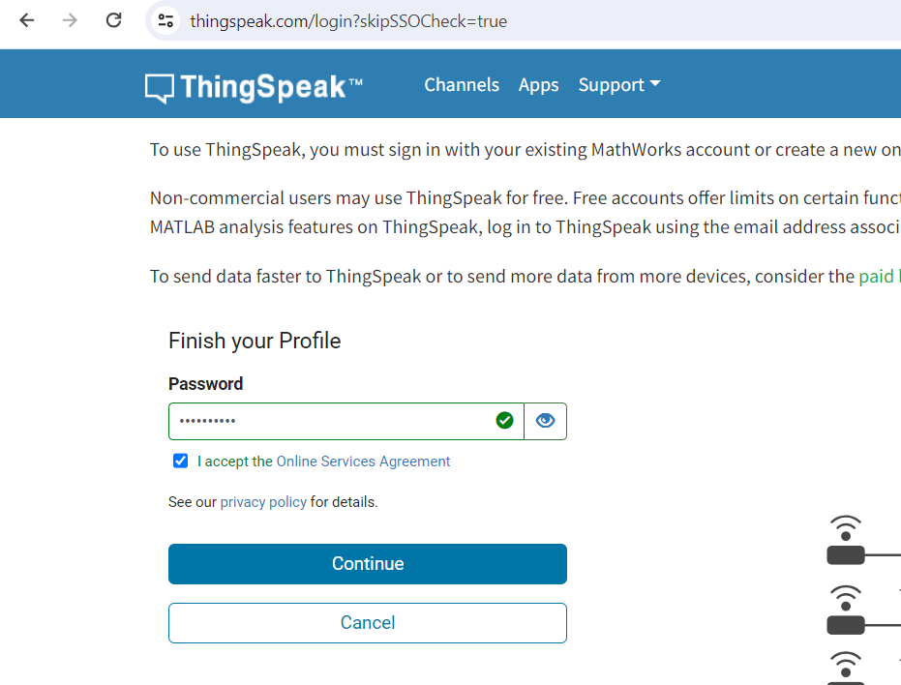
Valitse salasana, merkitse valintaruutu ja klikkaa Continue

Slide 6
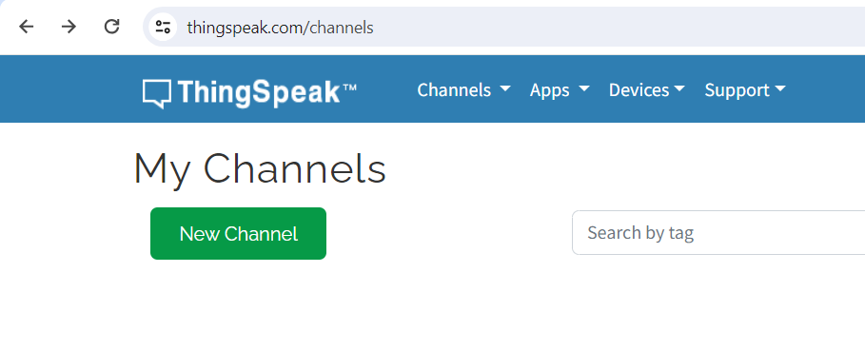
Klikkaa New Channel

Slide 7
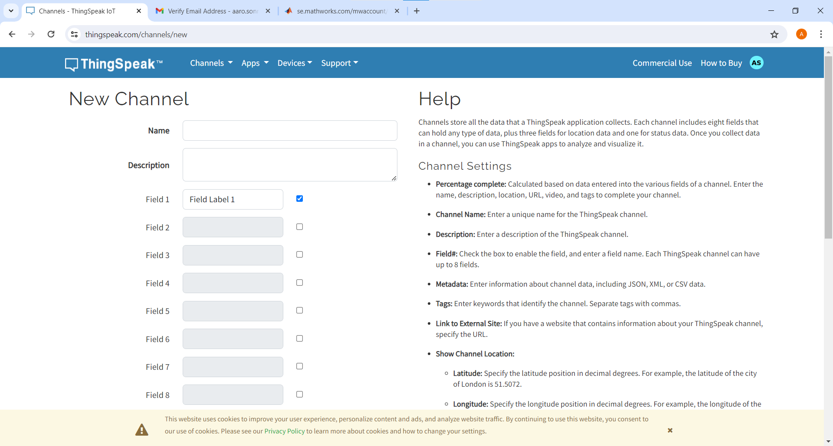

Slide 8
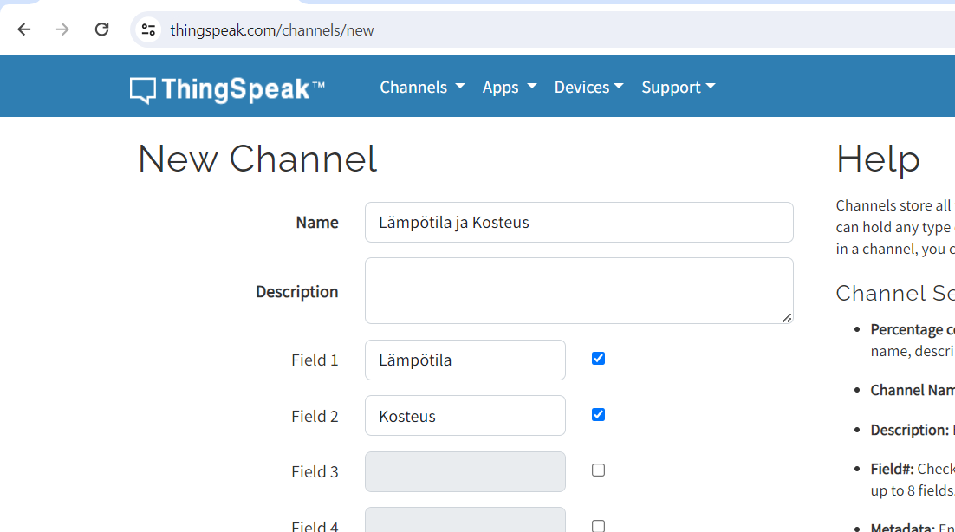
Täytä tiedot

Slide 9
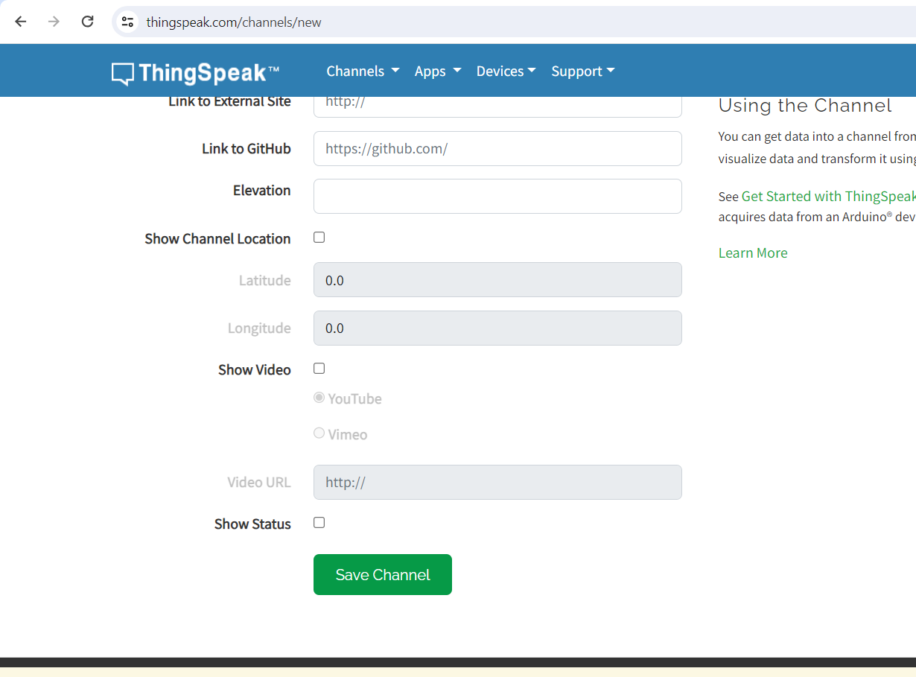
Klikkaa alempana sivulla olevaa Save Channel -nappia

Slide 10
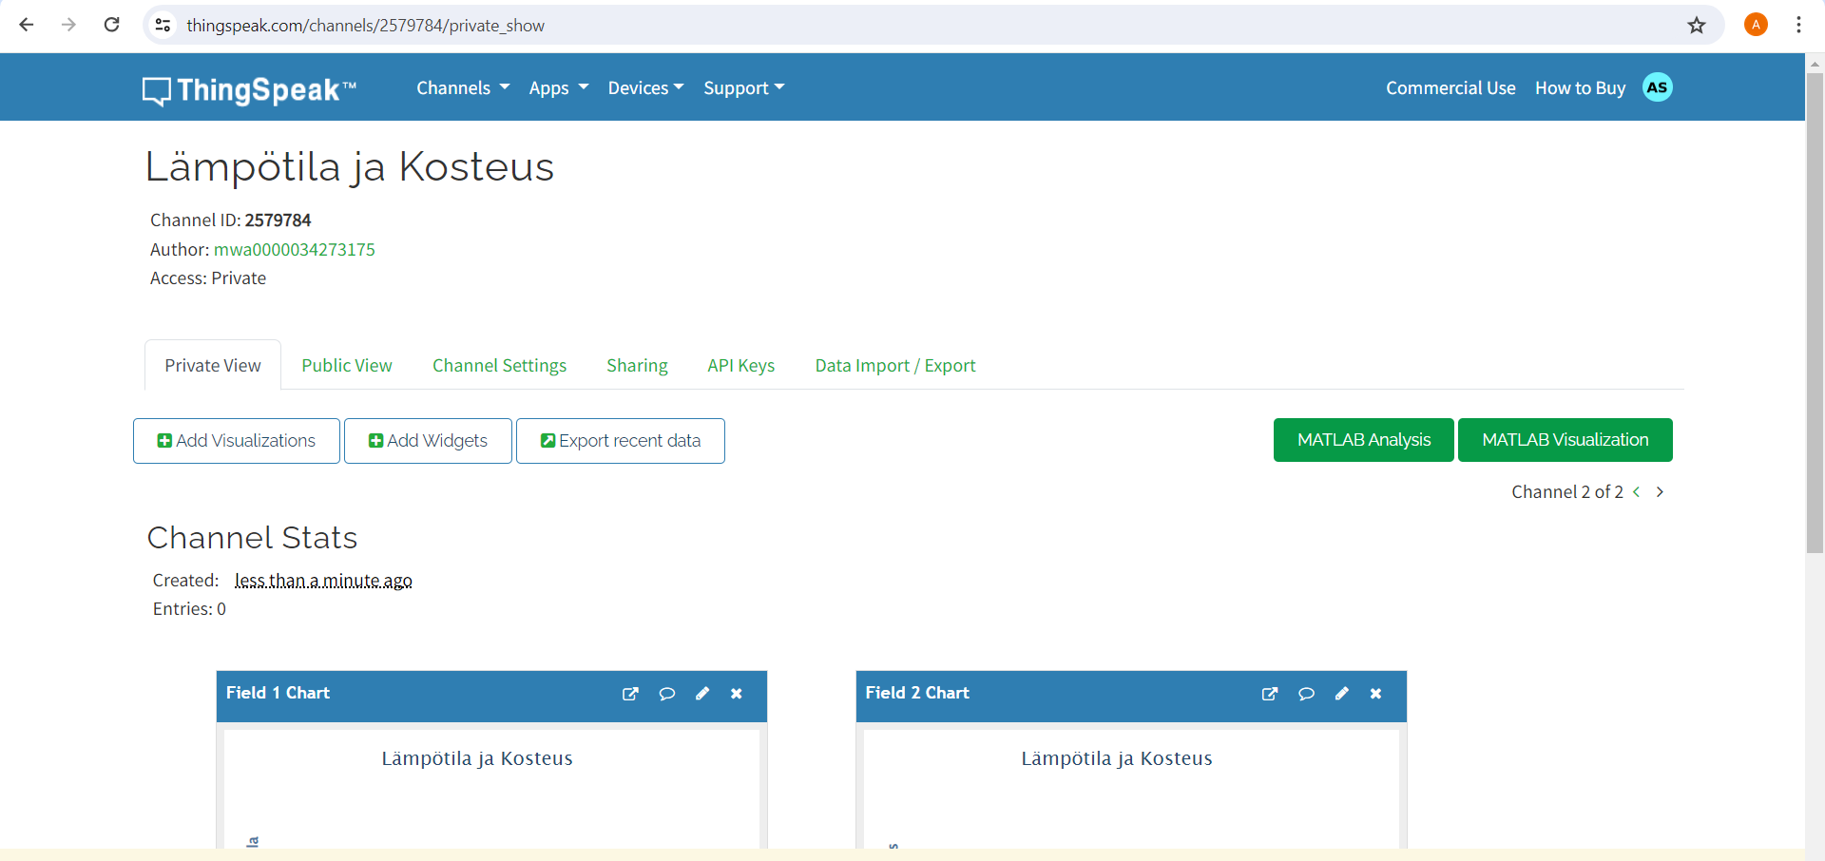
Avaa Api Keys sivu

Slide 11
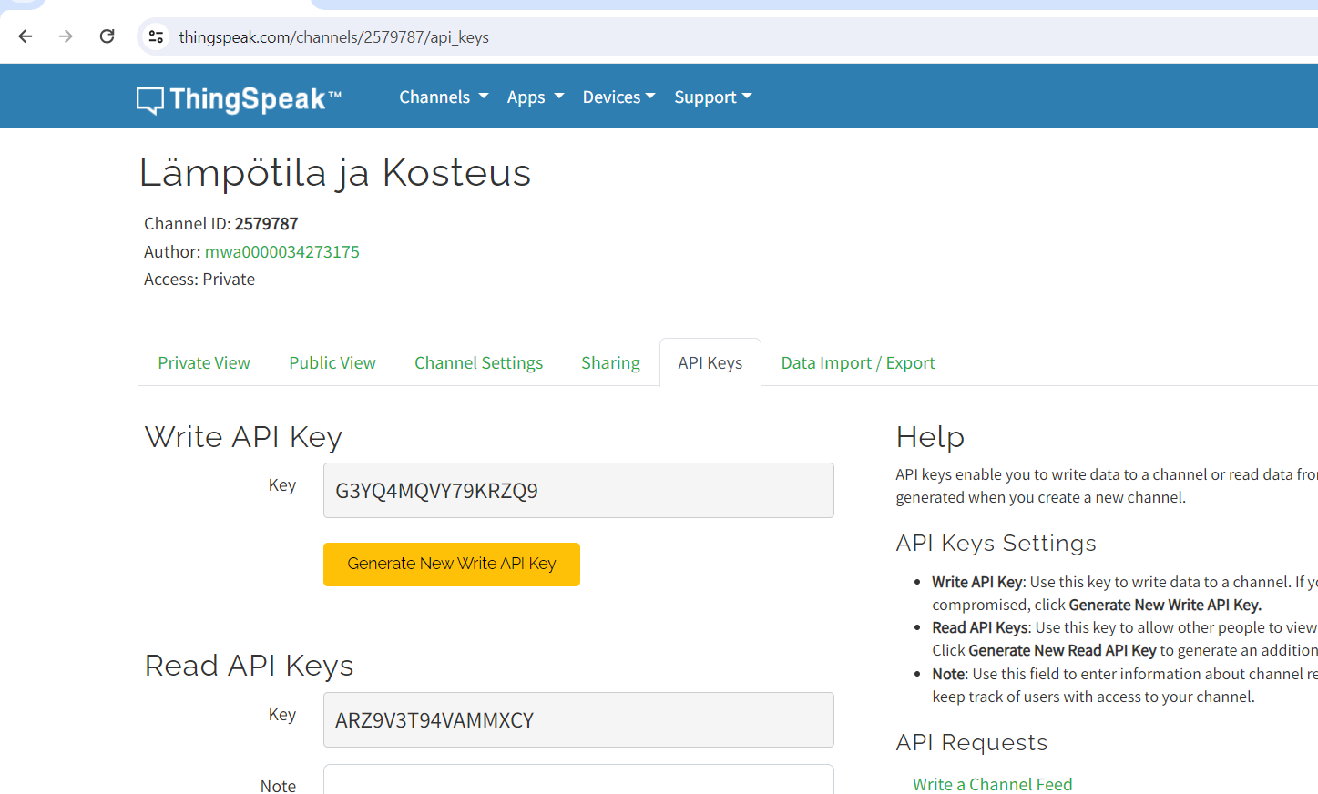
Kopioi Write API Key

Slide 12
Copy Code and Change Line That Are Commented
#include <DHT.h>
#include <ESP8266WiFi.h>
String apiKey = "G3YQ4MQVY79KRZQ9"; // Enter your Write API key from ThingSpeak
const char *ssid = "aalto open"; // replace with your wifi ssid and wpa2 key
const char *pass = "";
const char *server = "api.thingspeak.com";
#define DHTPIN 4
DHT dht(DHTPIN, DHT11);
WiFiClient client;
void setup() {
Serial.begin(115200);
delay(10);
dht.begin();
Serial.println("Connecting to ");
Serial.println(ssid);
WiFi.begin(ssid, pass);
while (WiFi.status() != WL_CONNECTED) {
delay(500);
Serial.print(".");
}
Serial.println("");
Serial.println("WiFi connected");
}
void loop() {
float h = dht.readHumidity();
float t = dht.readTemperature();
if (isnan(h) || isnan(t)) {
Serial.println("Failed to read from DHT sensor!");
return;
}
if (client.connect(server, 80)) // "184.106.153.149" or api.thingspeak.com
{
String postStr = apiKey;
postStr += "&field1=";
postStr += String(t);
postStr += "&field2=";
postStr += String(h);
postStr += "\r\n\r\n";
client.print("POST /update HTTP/1.1\n");
client.print("Host: api.thingspeak.com\n");
client.print("Connection: close\n");
client.print("X-THINGSPEAKAPIKEY: " + apiKey + "\n");
client.print("Content-Type: application/x-www-form-urlencoded\n");
client.print("Content-Length: ");
client.print(postStr.length());
client.print("\n\n");
client.print(postStr);
Serial.print("Temperature: ");
Serial.print(t);
Serial.print(" degrees Celcius, Humidity: ");
Serial.print(h);
Serial.println("%. Send to Thingspeak.");
}
client.stop();
Serial.println("Waiting...");
delay(20000);
}

Slide 13
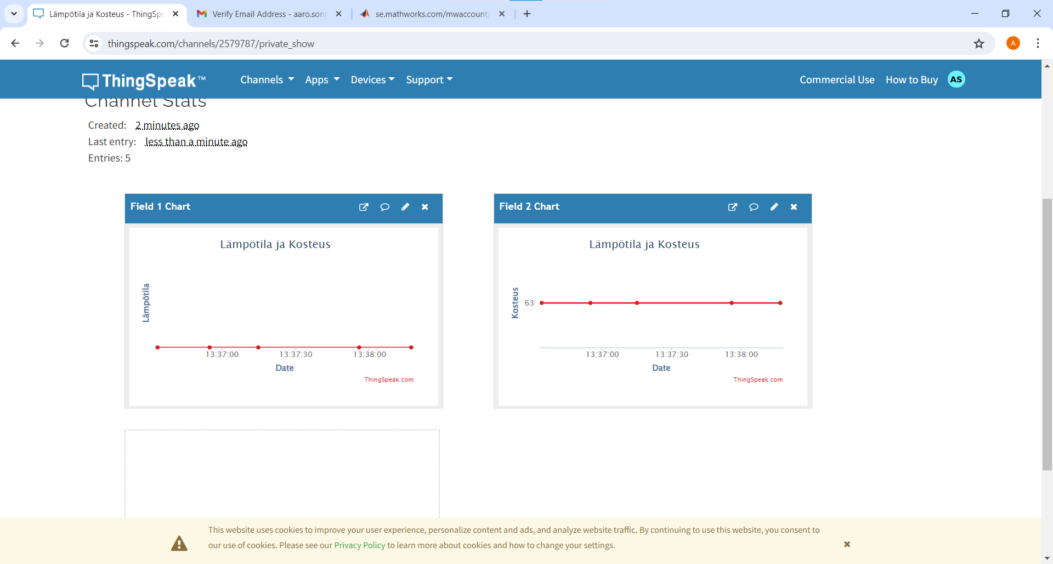
Go Page Private View

