Slide 1
File > Examples > Basics > Blink
void setup() {
pinMode(LED_BUILTIN, OUTPUT);
}
void loop() {
digitalWrite(LED_BUILTIN, HIGH);
delay(1000);
digitalWrite(LED_BUILTIN, LOW);
delay(1000);
}

Slide 2
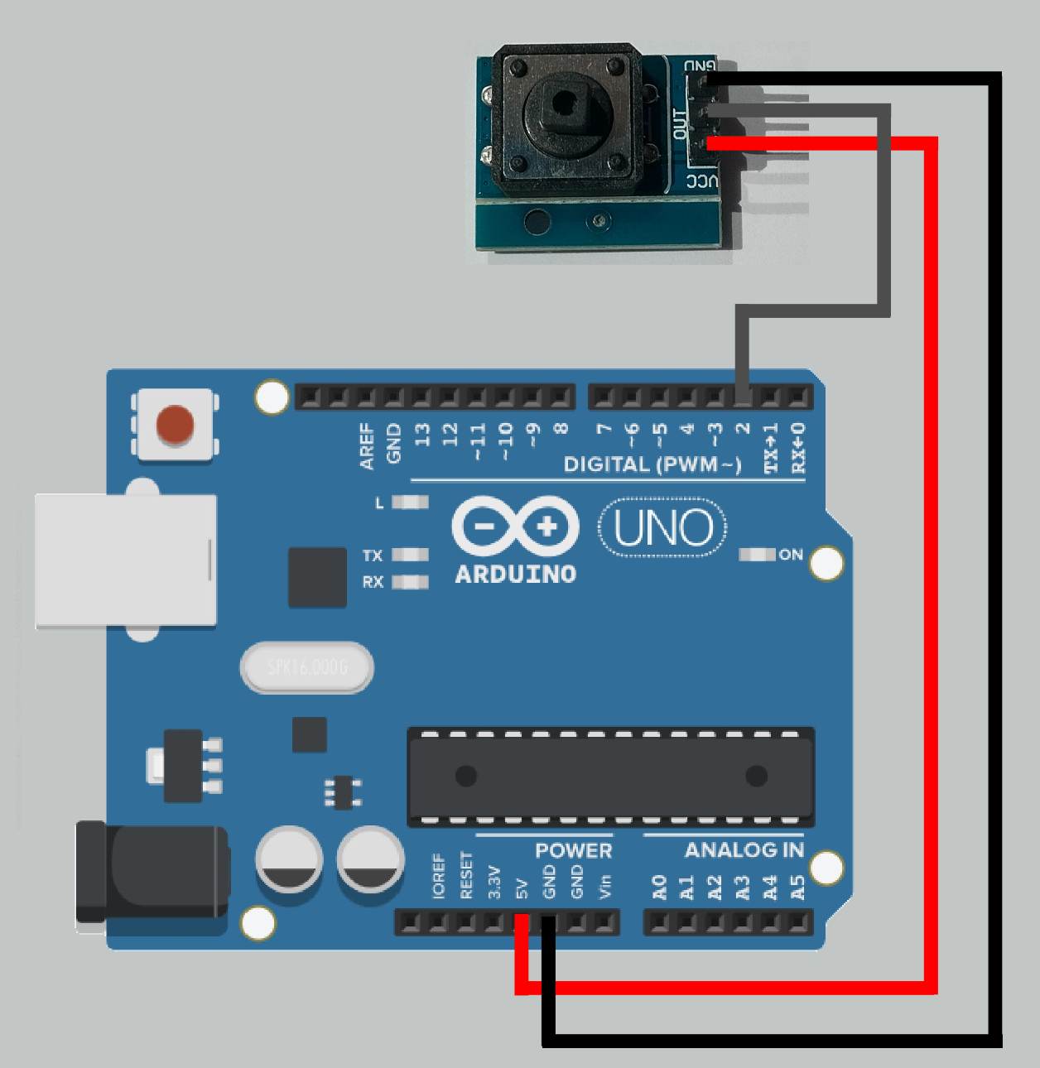
File > Examples > Basics > Button
const int buttonPin = 2;
const int ledPin = 13;
int buttonState = 0;
void setup() {
pinMode(ledPin, OUTPUT);
pinMode(buttonPin, INPUT);
}
void loop() {
buttonState = digitalRead(buttonPin);
if (buttonState == HIGH) {
digitalWrite(ledPin, HIGH);
} else {
digitalWrite(ledPin, LOW);
}
}

Slide 3
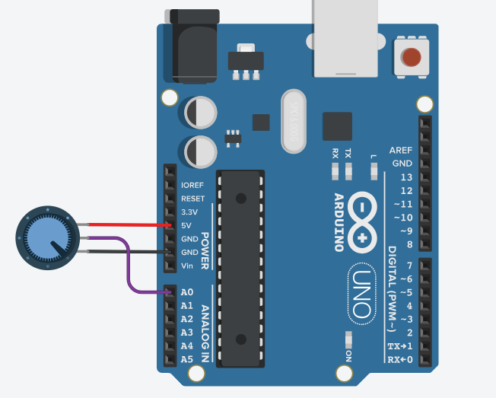
File > Examples > Basics > AnalogReadSerial
void setup() {
Serial.begin(9600);
}
void loop() {
int sensorValue = analogRead(A0);
Serial.println(sensorValue);
delay(1);
}

Slide 4
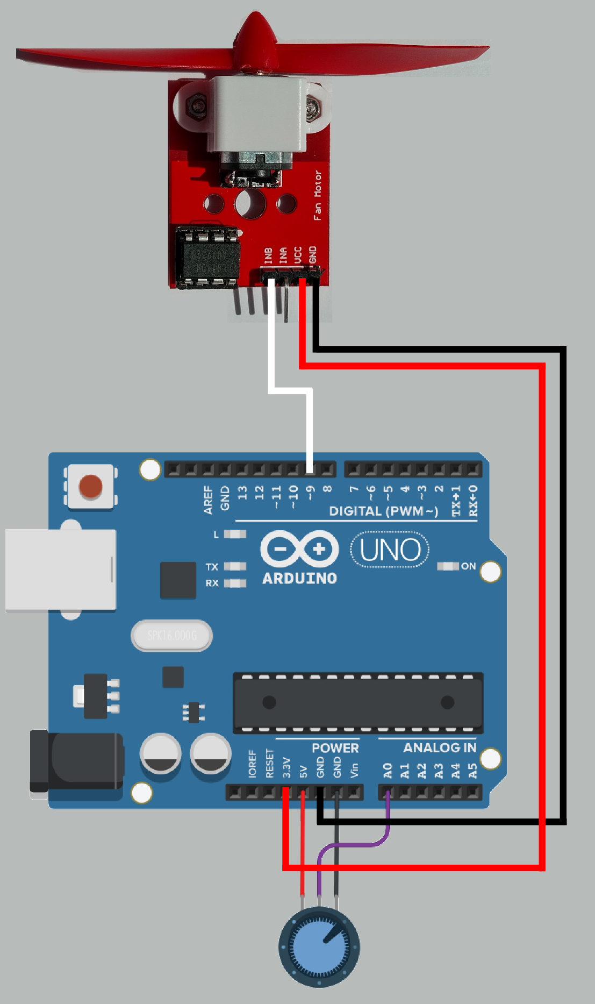
File > Examples > Analog > AnalogInOutSerial
const int analogInPin = A0;
const int analogOutPin = 9;
int sensorValue = 0;
int outputValue = 0;
void setup() {
Serial.begin(9600);
}
void loop() {
sensorValue = analogRead(analogInPin);
outputValue = map(sensorValue, 0, 1023, 0, 255);
analogWrite(analogOutPin, outputValue);
Serial.print("sensor = ");
Serial.print(sensorValue);
Serial.print("\t output = ");
Serial.println(outputValue);
delay(2);
}

Slide 5
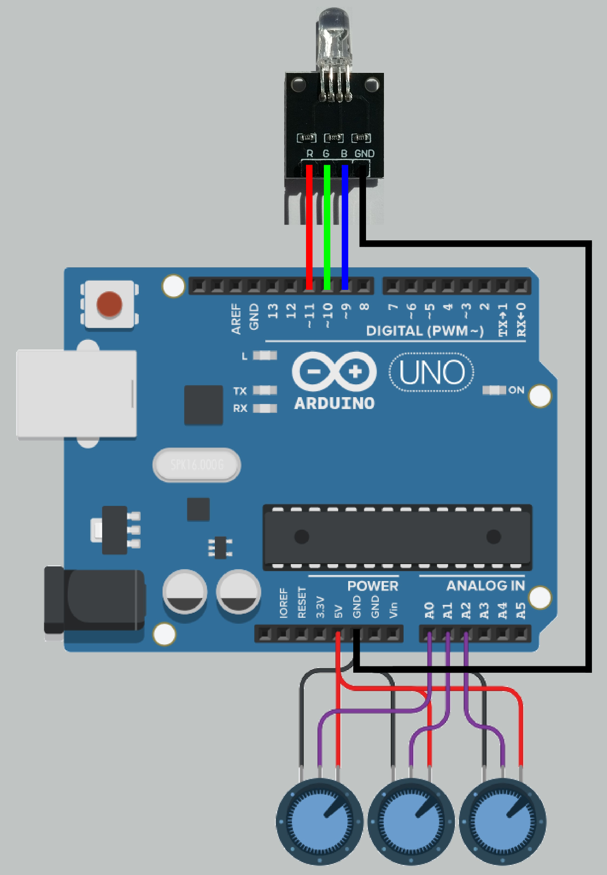
RGB Led + Potentiometrit
const int analogInPinR = A0;
const int analogInPinG = A1;
const int analogInPinB = A2;
const int analogOutPinR = 11;
const int analogOutPinG = 10;
const int analogOutPinB = 9;
int sensorValueR;
int sensorValueG;
int sensorValueB;
int outputValueR;
int outputValueG;
int outputValueB;
void setup() {
pinMode(analogOutPinR, OUTPUT);
pinMode(analogOutPinG, OUTPUT);
pinMode(analogOutPinB, OUTPUT);
}
void loop() {
sensorValueR = analogRead(analogInPinR);
sensorValueG = analogRead(analogInPinG);
sensorValueB = analogRead(analogInPinB);
outputValueR = map(sensorValueR, 0, 1023, 0, 255);
outputValueG = map(sensorValueG, 0, 1023, 0, 255);
outputValueB = map(sensorValueB, 0, 1023, 0, 255);
analogWrite(analogOutPinR, outputValueR);
analogWrite(analogOutPinG, outputValueG);
analogWrite(analogOutPinB, outputValueB);
delay(2);
}

Slide 6
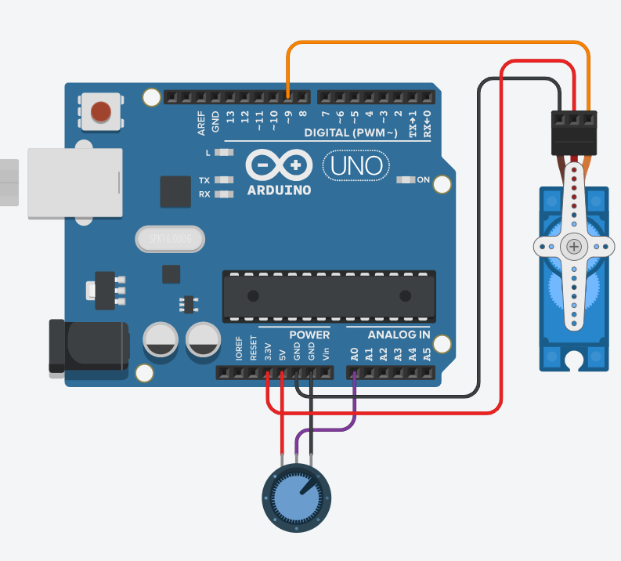
File > Examples > Servo > Knob
#include <Servo.h>
Servo myservo;
int potpin = A0;
int val;
void setup() {
myservo.attach(9);
}
void loop() {
val = analogRead(potpin);
val = map(val, 0, 1023, 180, 0);
myservo.write(val);
delay(15);
}

Slide 7
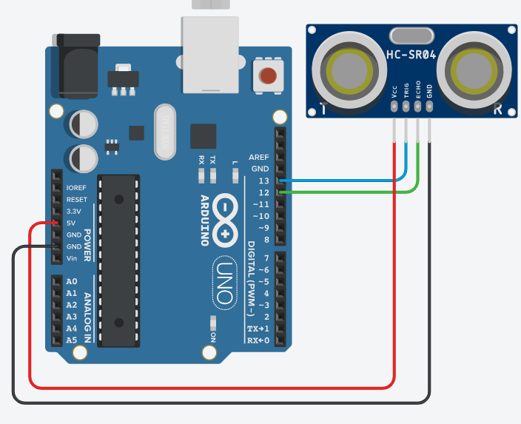
File > Examples > Afstandssensor > Afstand
#include <afstandssensor.h>
AfstandsSensor afstandssensor(13, 12);
void setup () {
Serial.begin(9600);
}
void loop () {
Serial.println(afstandssensor.afstandCM());
delay(500);
}

Slide 8
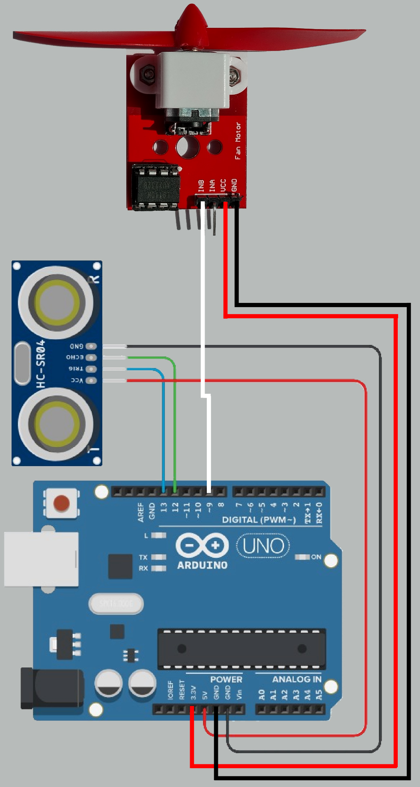
Etäisyys + Tuuletin
#include <afstandssensor.h>
AfstandsSensor afstandssensor(13, 12);
const int outPin = 9;
int dist;
void setup () {
pinMode(outPin, OUTPUT);
Serial.begin(9600);
}
void loop () {
dist = afstandssensor.afstandCM();
Serial.println(dist);
analogWrite(outPin, map(dist, 0, 100, 0, 255));
delay(50);
}

Slide 9
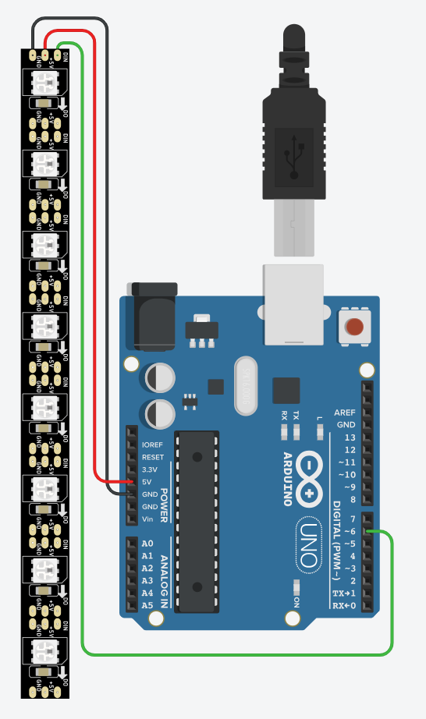
Led-nauha
#include <FastLED.h>
FASTLED_USING_NAMESPACE
#define DATA_PIN 6
#define LED_TYPE WS2811
#define COLOR_ORDER GRB
#define NUM_LEDS 8
CRGB leds[NUM_LEDS];
#define BRIGHTNESS 96
#define FRAMES_PER_SECOND 120
void setup() {
delay(3000);
FastLED.addLeds<LED_TYPE,DATA_PIN,COLOR_ORDER>(leds, NUM_LEDS).setCorrection(TypicalLEDStrip);
FastLED.setBrightness(BRIGHTNESS);
}
uint8_t gHue = 0;
void loop() {
bpm();
FastLED.show();
FastLED.delay(1000/FRAMES_PER_SECOND);
EVERY_N_MILLISECONDS( 20 ) { gHue++; }
}
void bpm() {
uint8_t BeatsPerMinute = 62;
CRGBPalette16 palette = PartyColors_p;
uint8_t beat = beatsin8( BeatsPerMinute, 64, 255);
for( int i = 0; i < NUM_LEDS; i++) {
leds[i] = ColorFromPalette(palette, gHue+(i*2), beat-gHue+(i*10));
}
}

